Slide 1
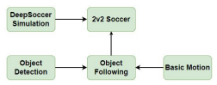
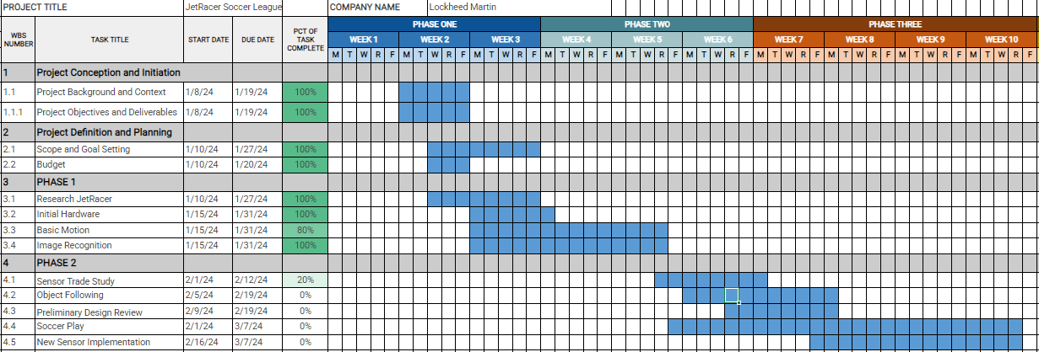
Overview
JetRacer Soccer Jarod Marshel, Casey Rittenhouse, Arjun Simha, Mason Kang, K Gupta, Julie Ham, Cooper Ritter
Overall Concept:
Overall Project Deliverable | Progress
Basic Movement | In progress
Image recognition | Done
New sensor implementation | In progress
Object following/Ball Striking | In progress
Co-op and Versus | Not started
Github with documentation | Not started
Summary and report | Not started
New Sensor
Project is On Schedule
Gantt Chart/Schedule

Slide 2
Short-Term
JetRacer Soccer Jarod Marshel, Casey Rittenhouse, Arjun Simha, Mason Kang, K Gupta, Julie Ham, Cooper Ritter
Previous Meeting Action Items:
Item | Description | Owner | Target Date | Status
1 | Car CAD Models | Cooper | Feb 12 | Done
2 | Unity soccer simulation training | Mason | Jan 31 | Done
3 | Get all cars working with basic movement | Everyone | Feb 9 | In progress
4 | Redo hardware attachment to cars | Everyone | Feb 12 | Done
5 | Demonstrate image processing | Everyone | Jan 31 | Done
6 | Integrate ROS onto cars | Everyone | Feb 12 | In progress
7
Biweekly Action Items:
Item | Description | Owner | Target Date | Status
1 | System integration | Everyone | Feb 29 | Not started
2 | Preliminary Design Review | Everyone | Feb 19 | Not started
3 | Object following | Everyone | Feb 12 | In progress
4 | Build field for cars | Everyone | Feb 19 | Not started
5 | Implement SLAM into LIDAR systems | Everyone | Feb 12 | In progress
Significant Roadblocks/ Non-developing Items:
Budget:
Currently have 3 working cars (4th car may need to replace motor)
Total Proposed | Plan to Date | Used to Date | Used Vs Plan
$3500 USD | $0 USD | $0 USD | +/-$0 USD
Short Term Schedule:
Request for teaching staff:
Jan |  |  |  |  |  |  |  |  |  | Feb
5 |  |  |  |  | 12 |  |  |  |  | 19
Begin implementing object folowing
Begin field construction

Slide 3
Progress:
Detail
Setup LIDAR packages (drivers and hector SLAM) on Jetson Nano
Learned capabilities of LIDAR: tested for crosstalk, created point cloud visualization, tested mapping capabilities
Made ROS navigation package
Setup VNC
Modelled and printed brackets for mounting components
Worked on CV algorithm: YOLOv7 object detection runs

Slide 4
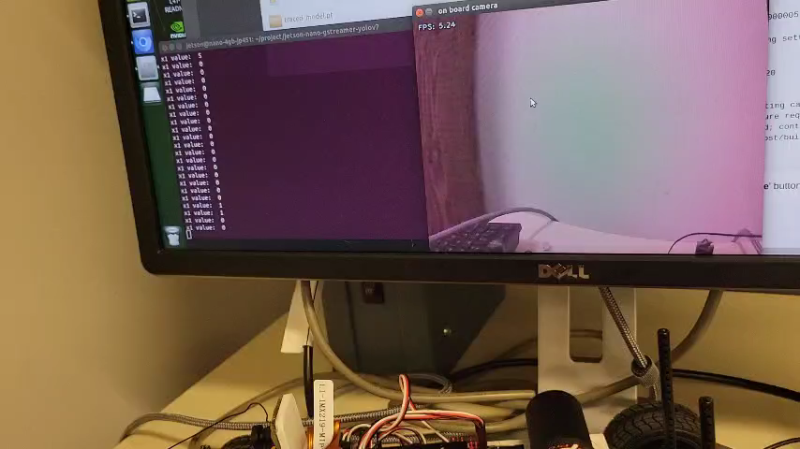
Detail

Slide 5
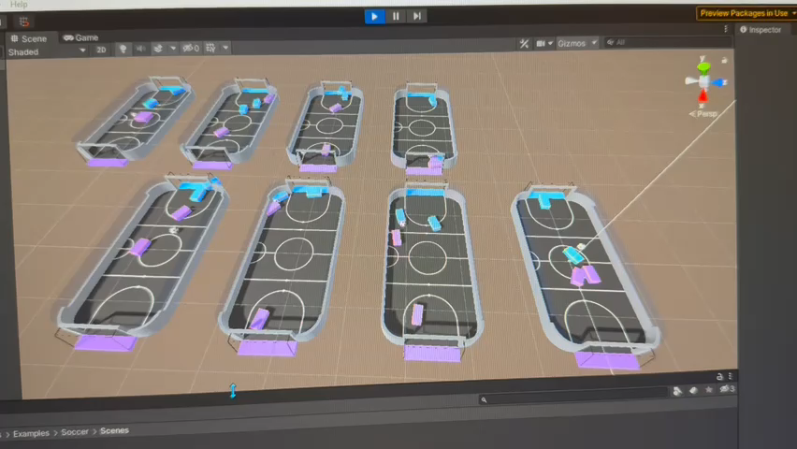
Detail

Slide 6
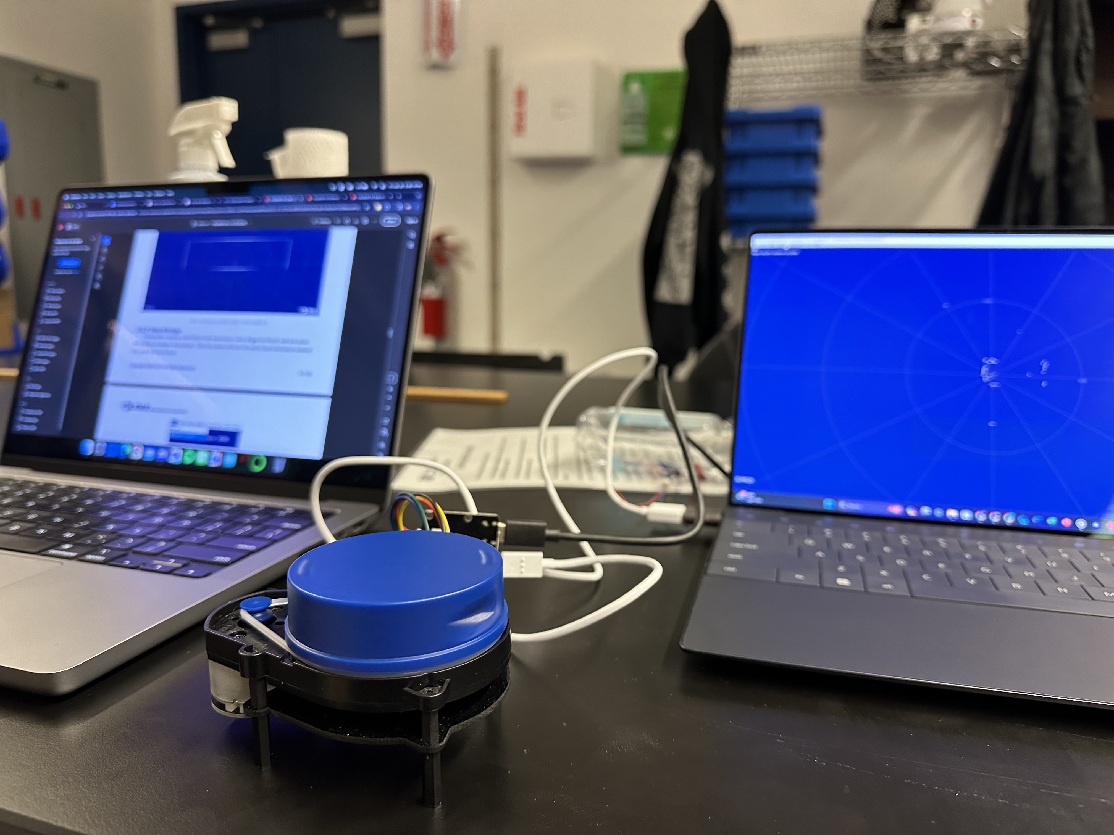
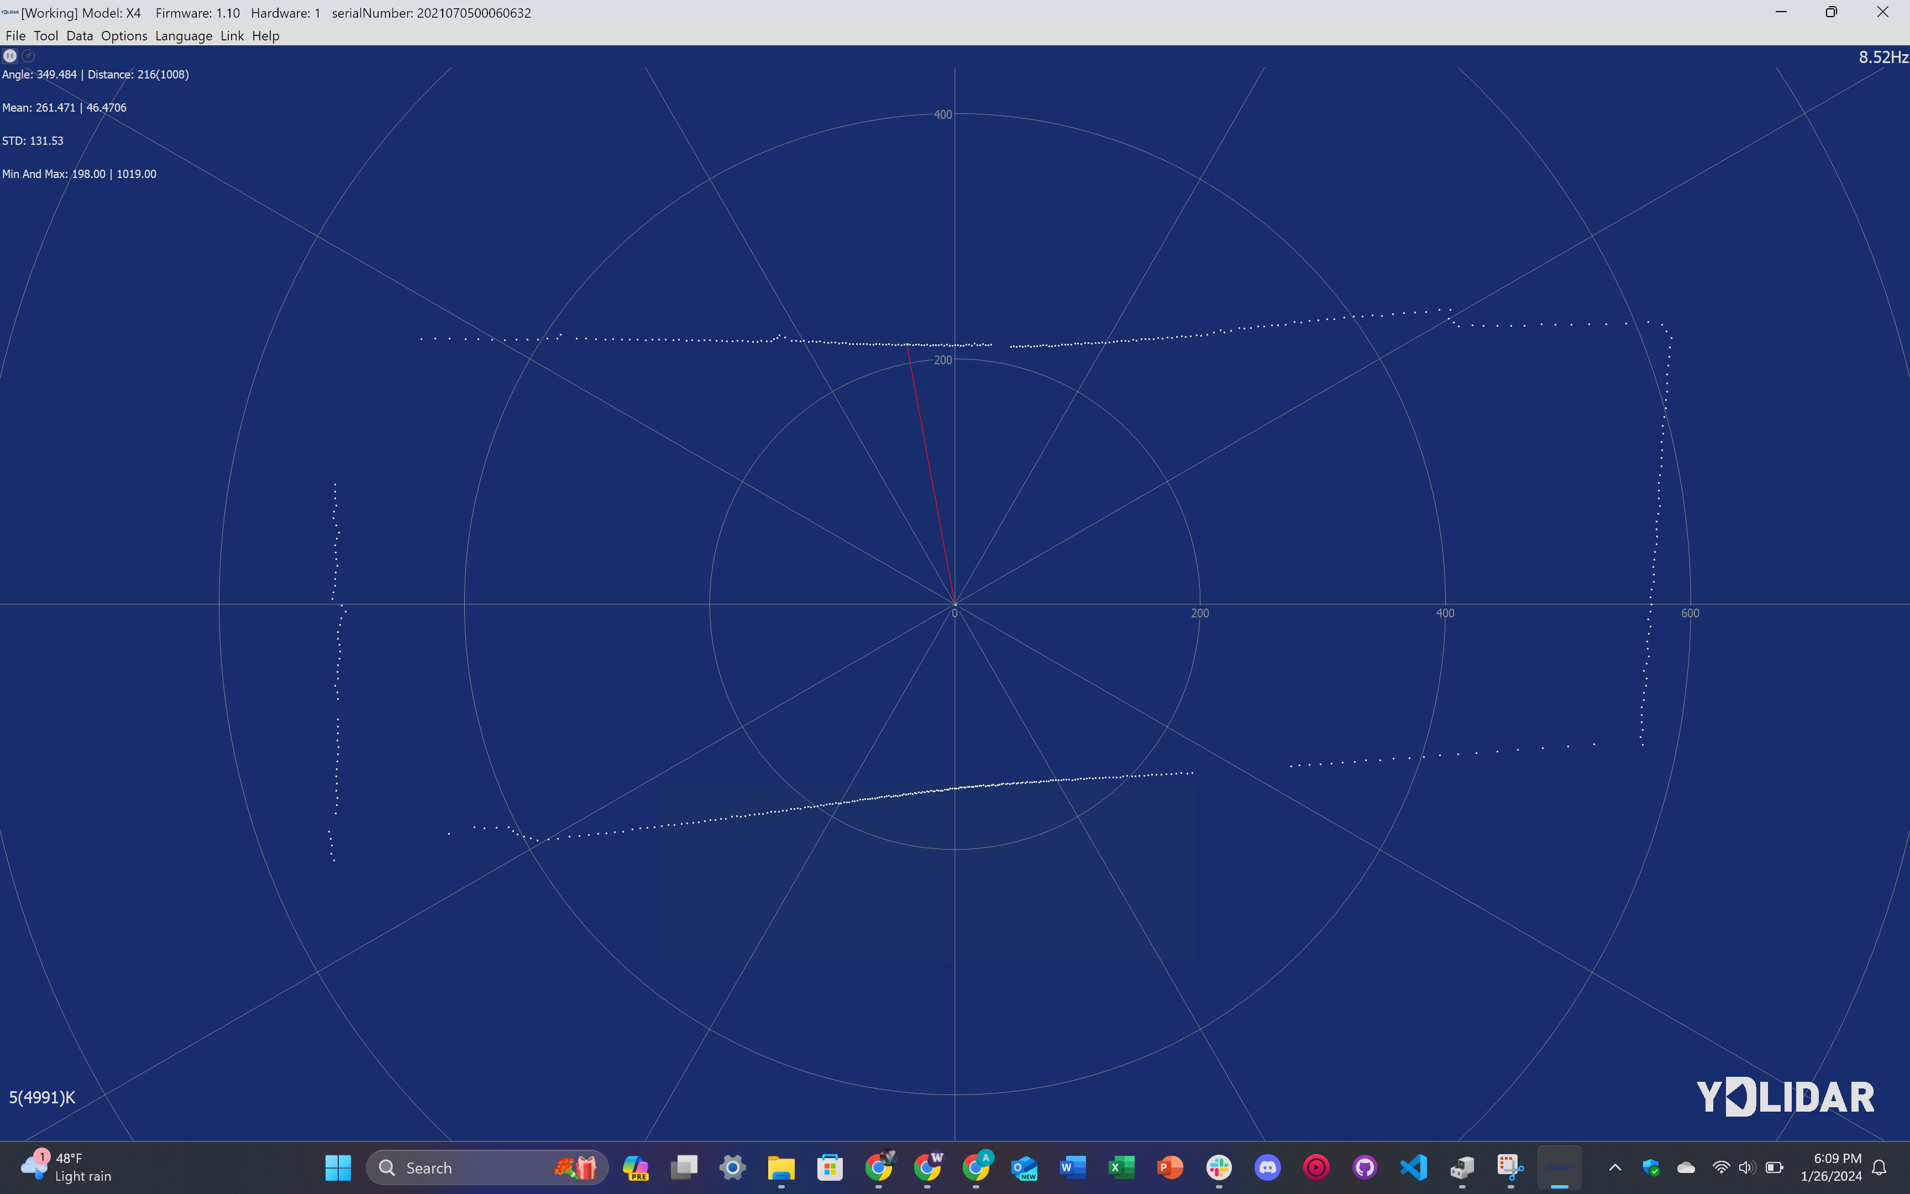

Slide 7
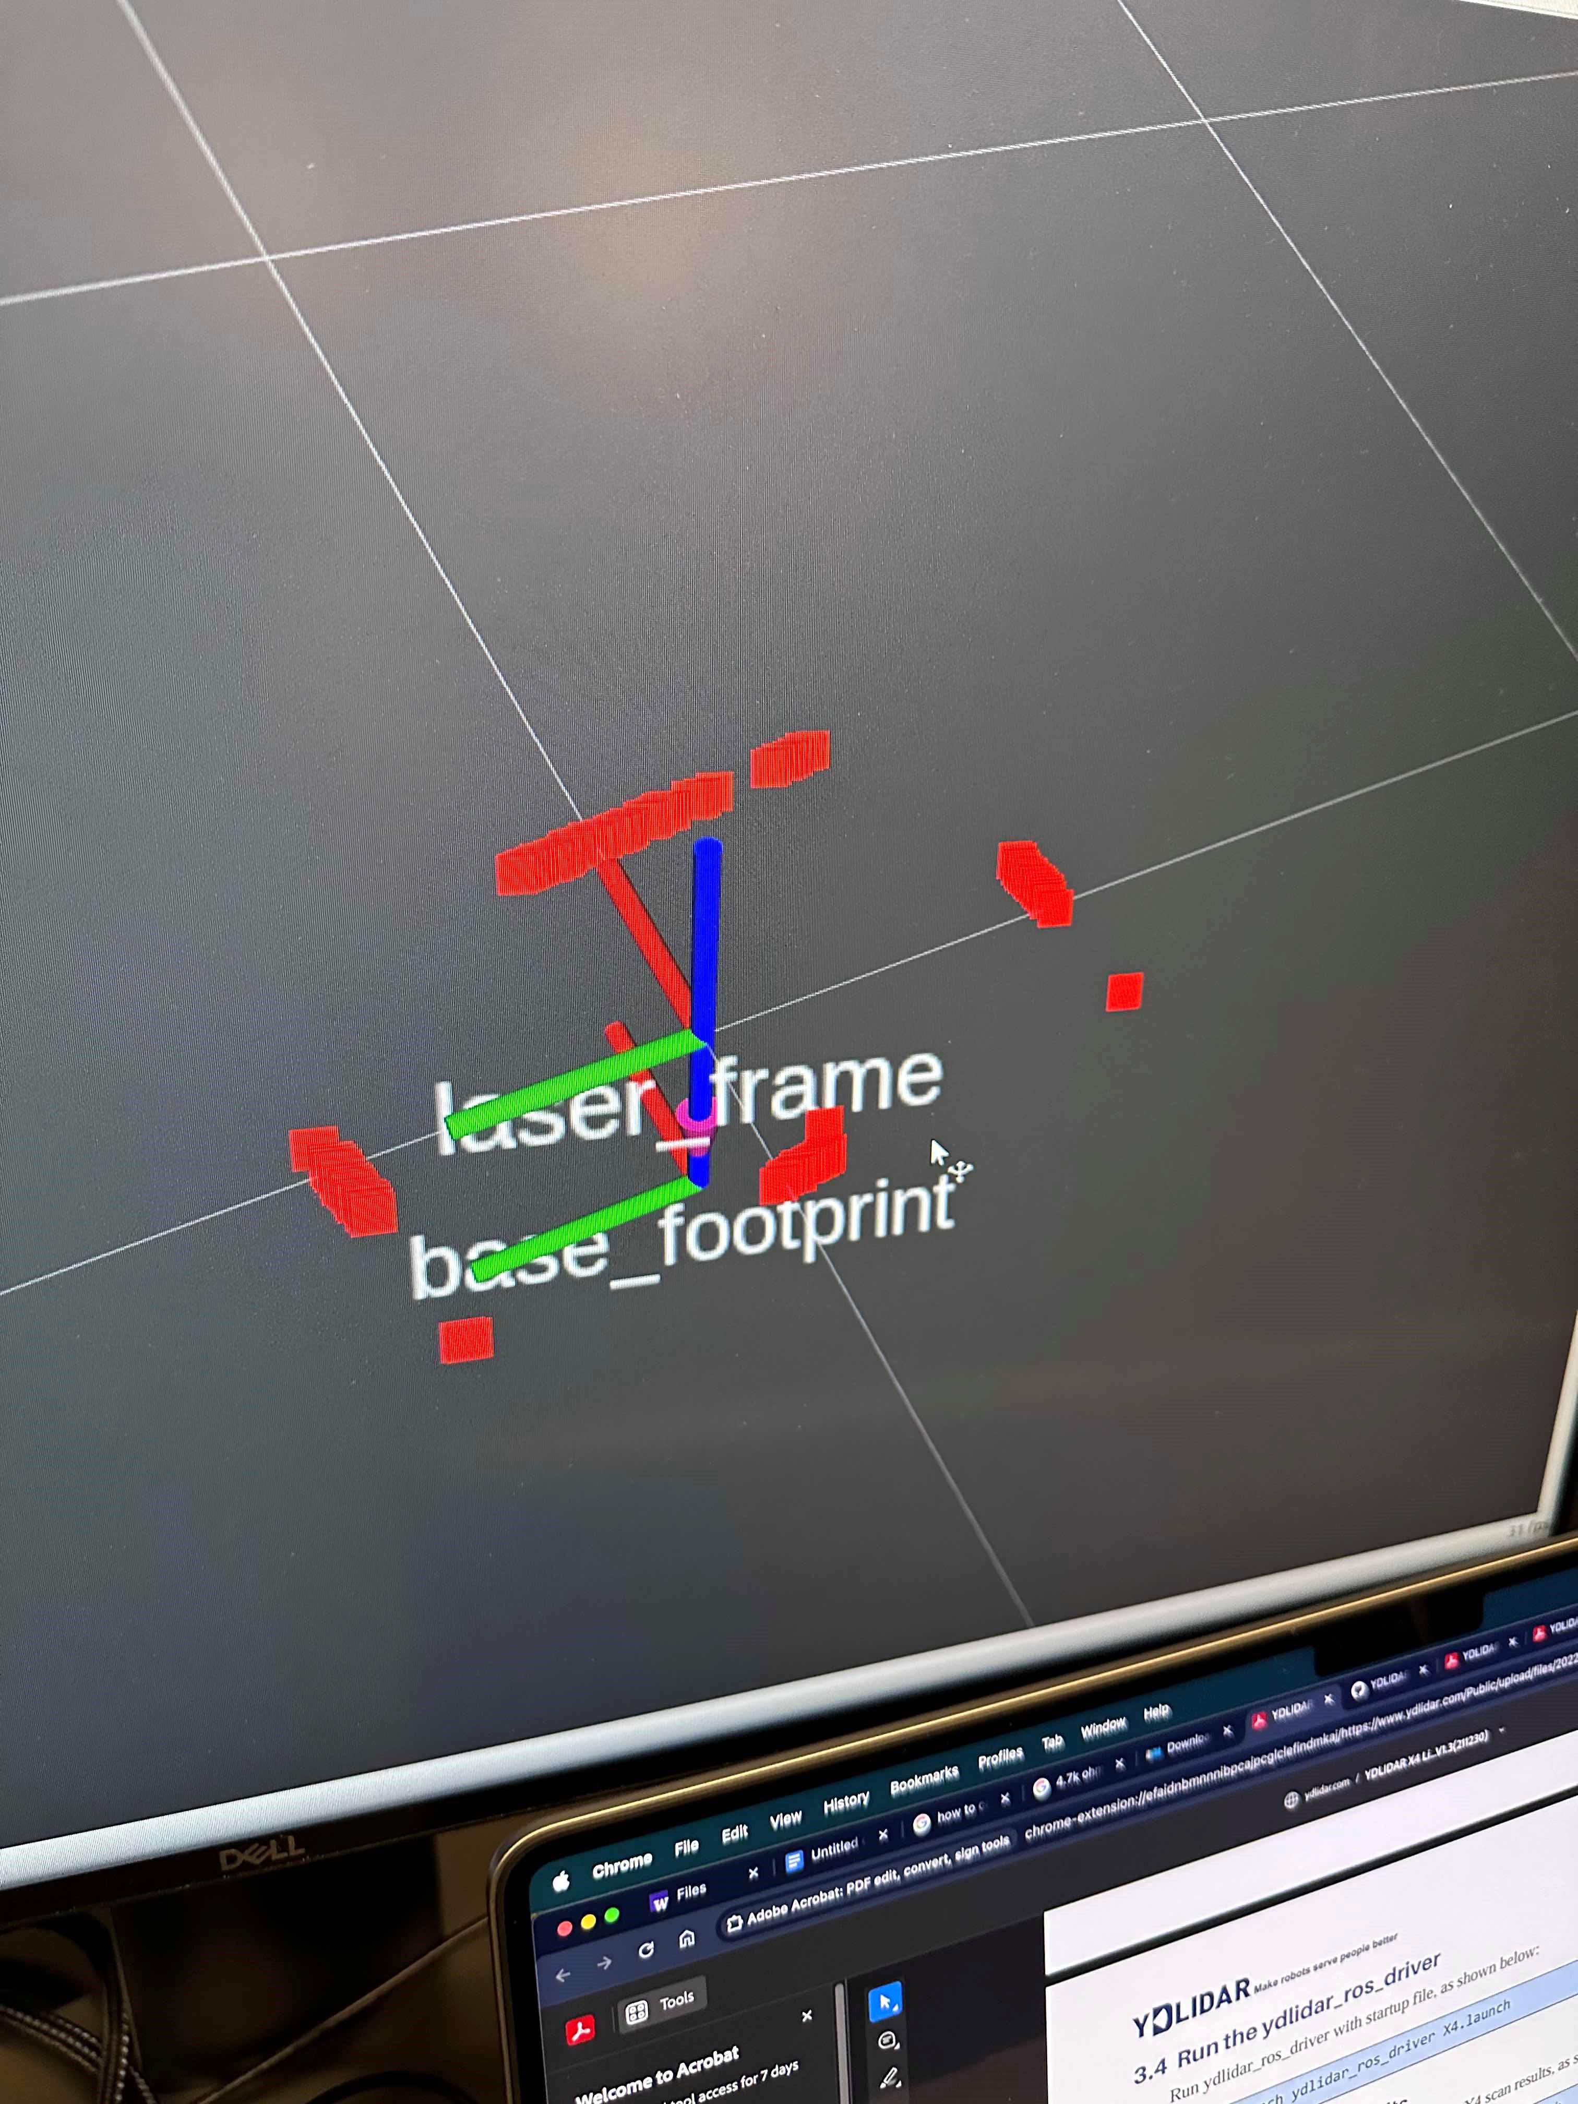
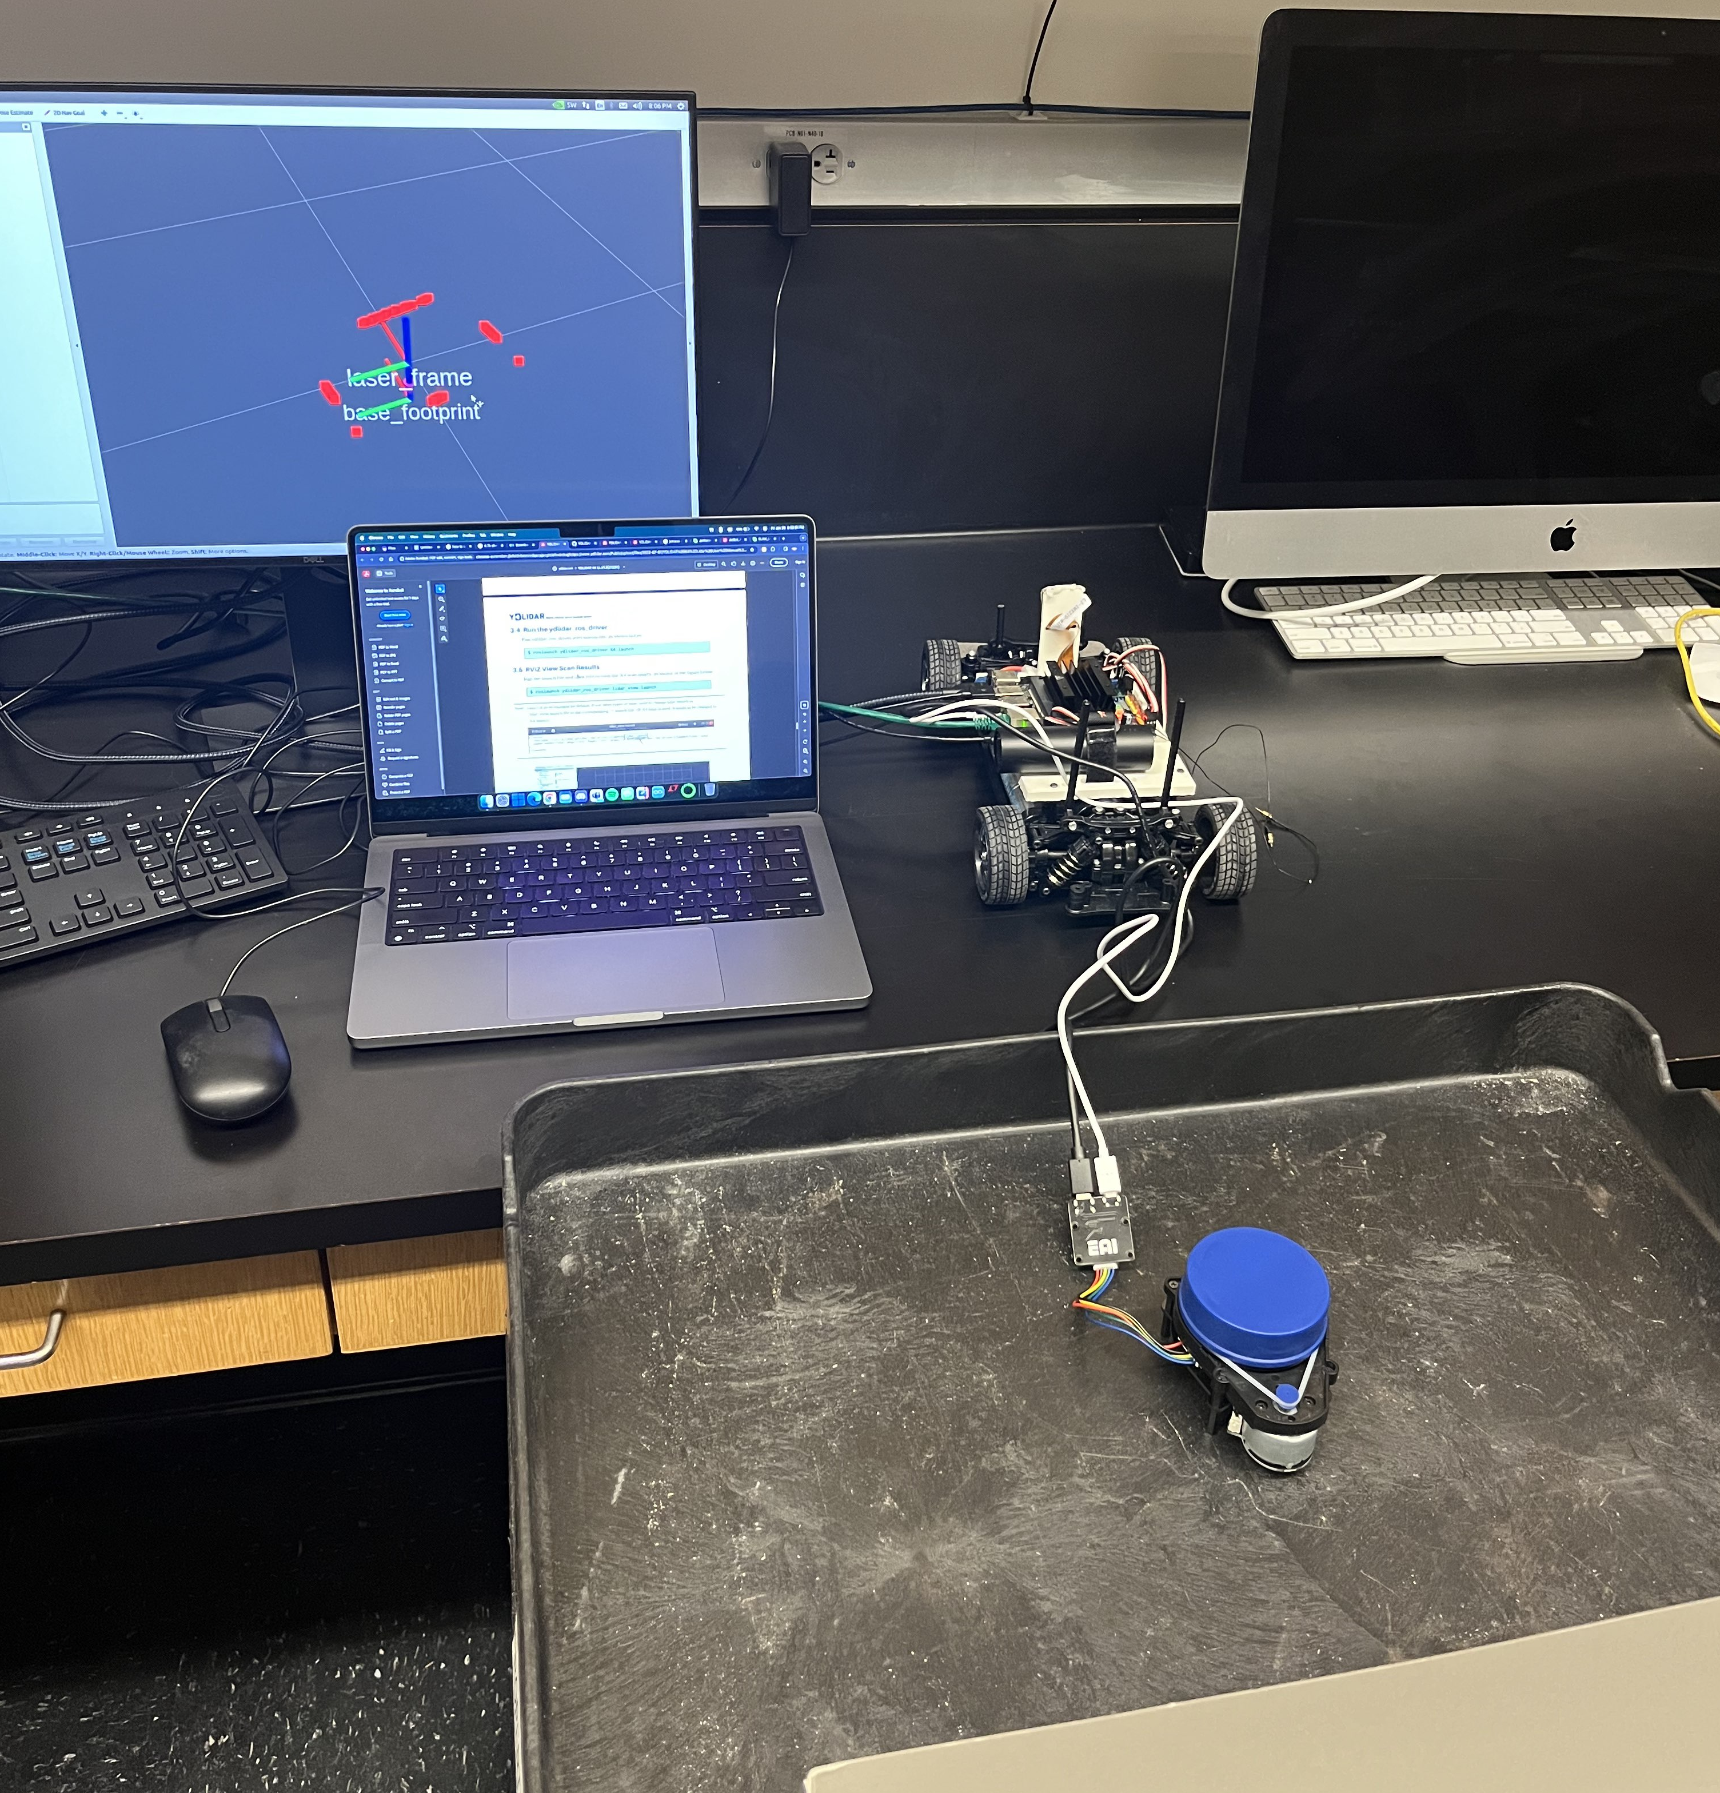

Slide 8
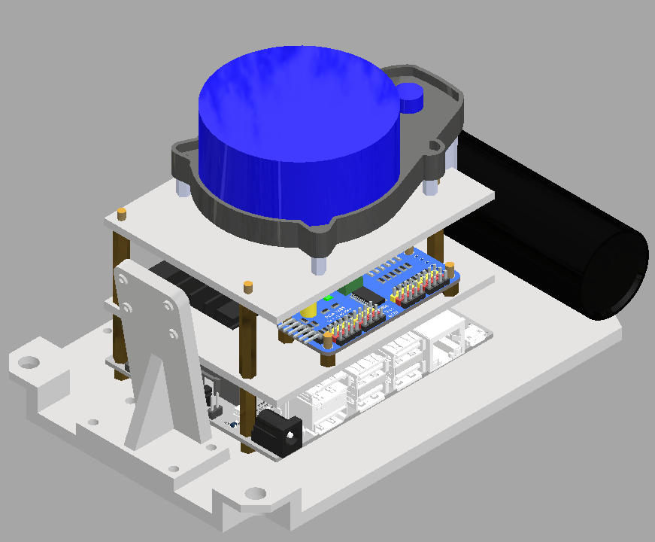

Slide 9
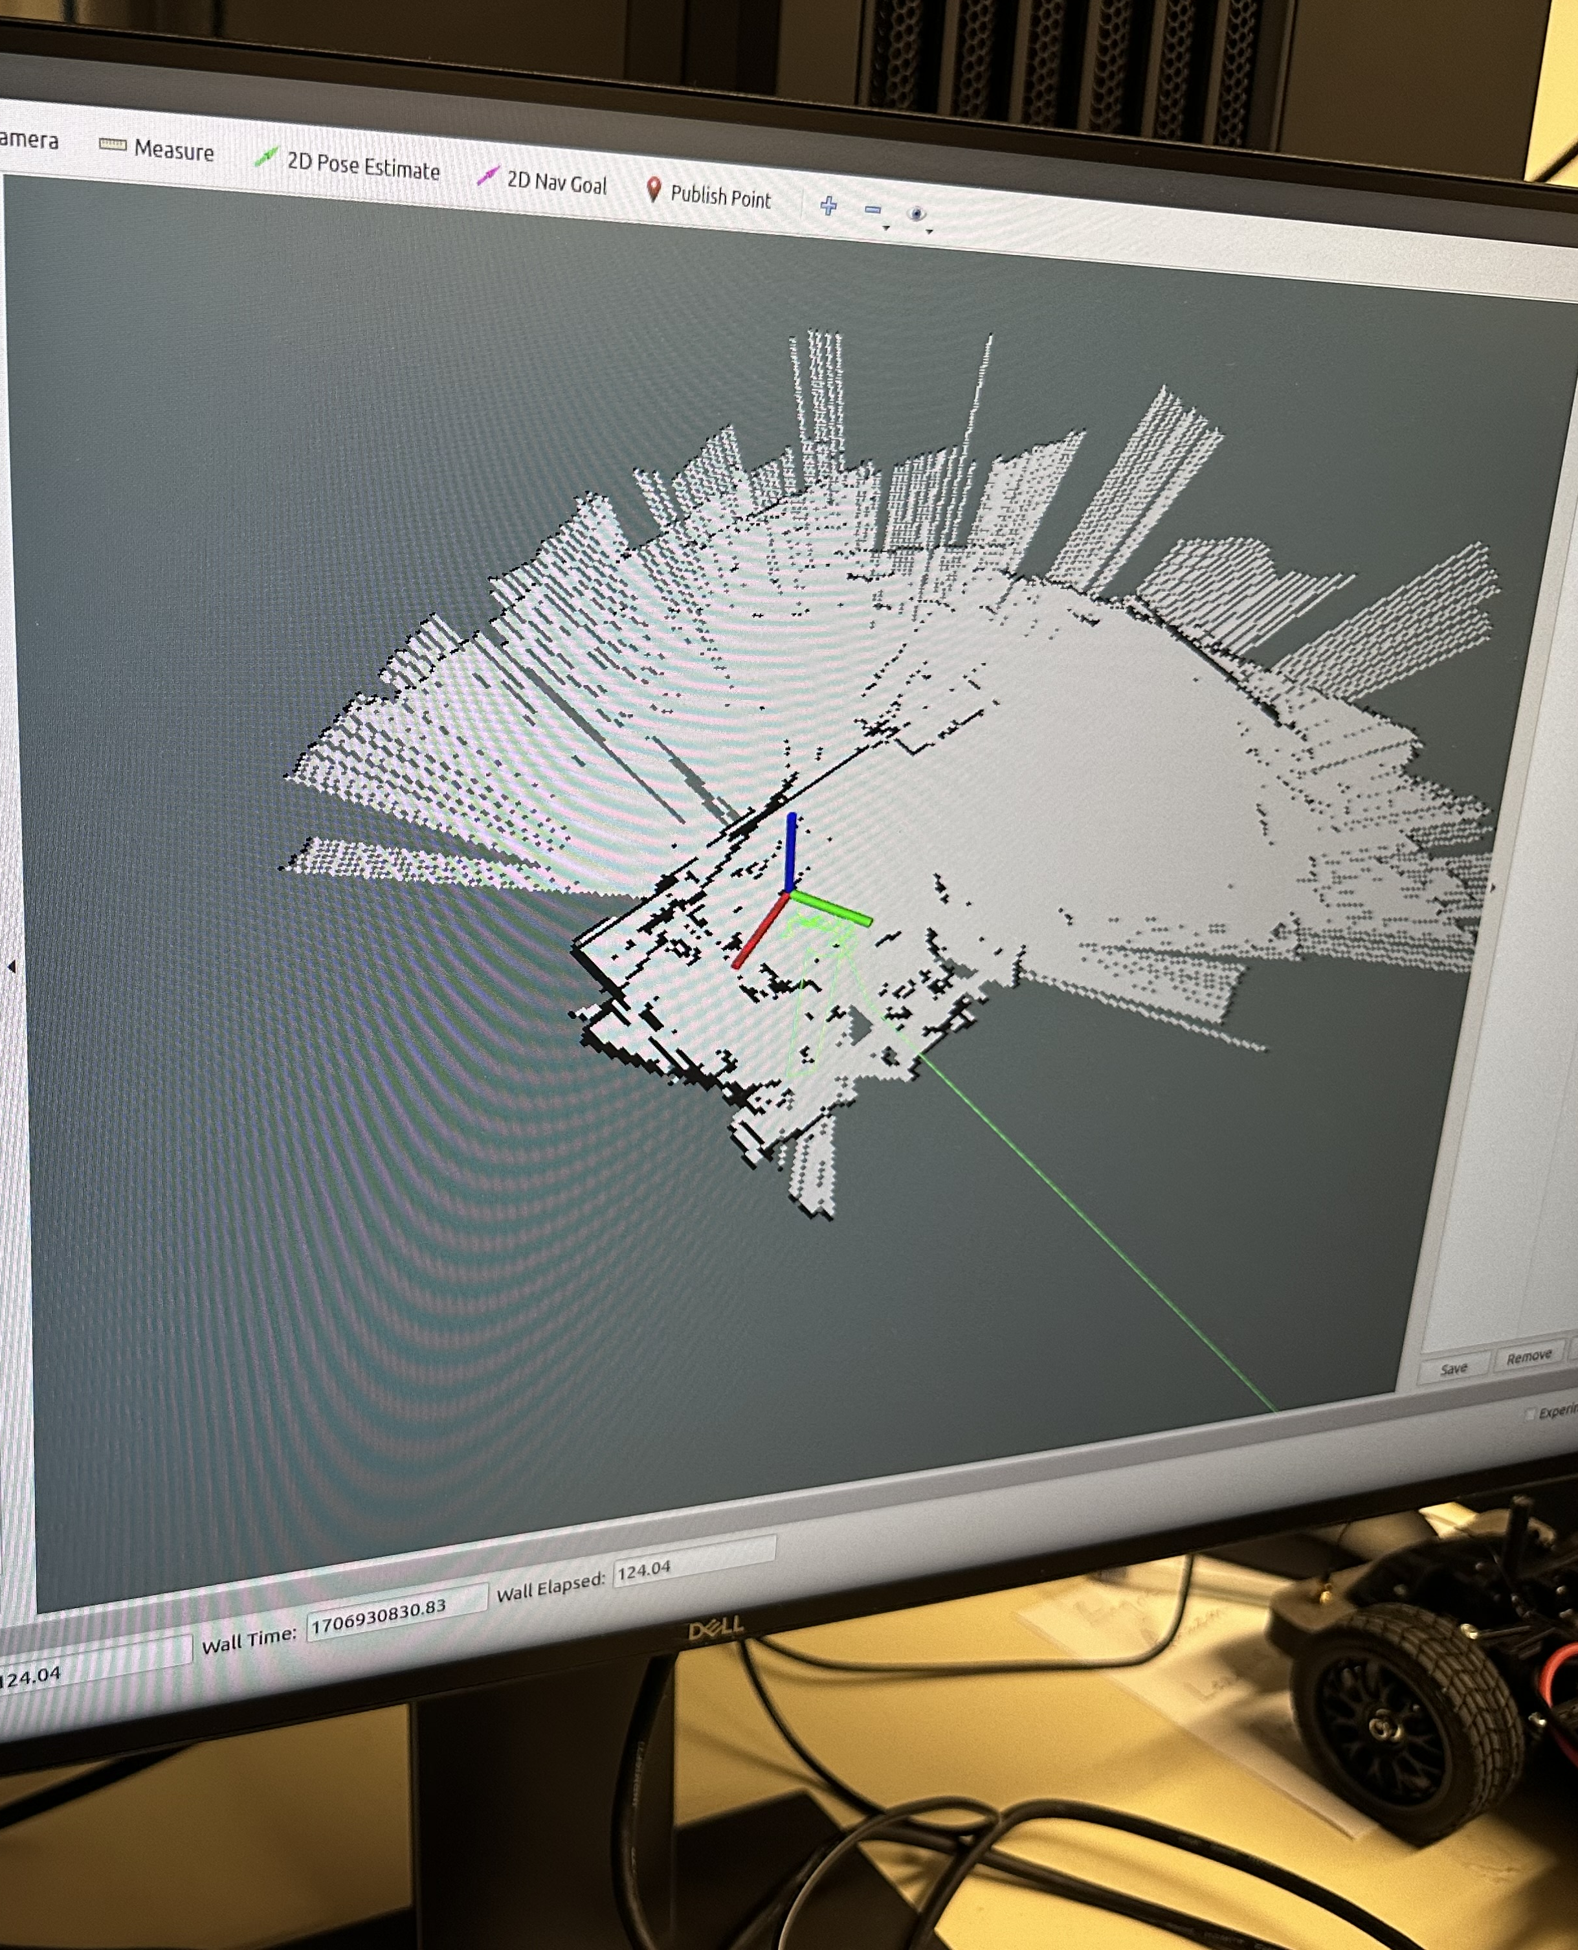
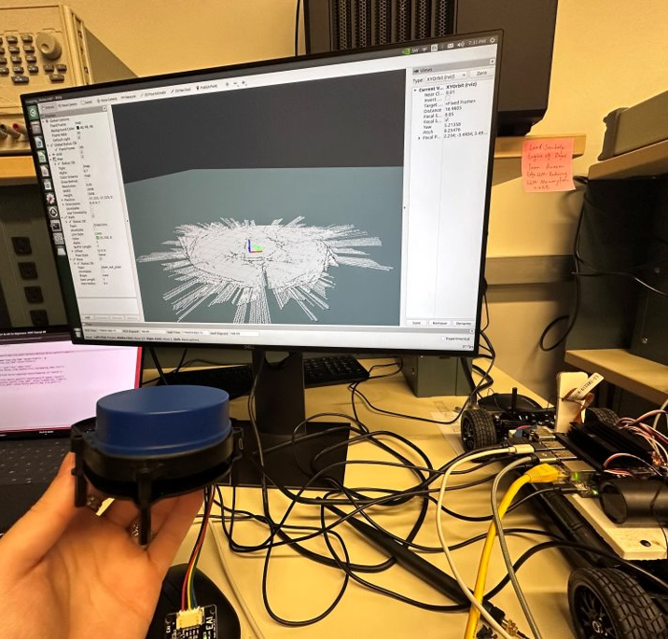
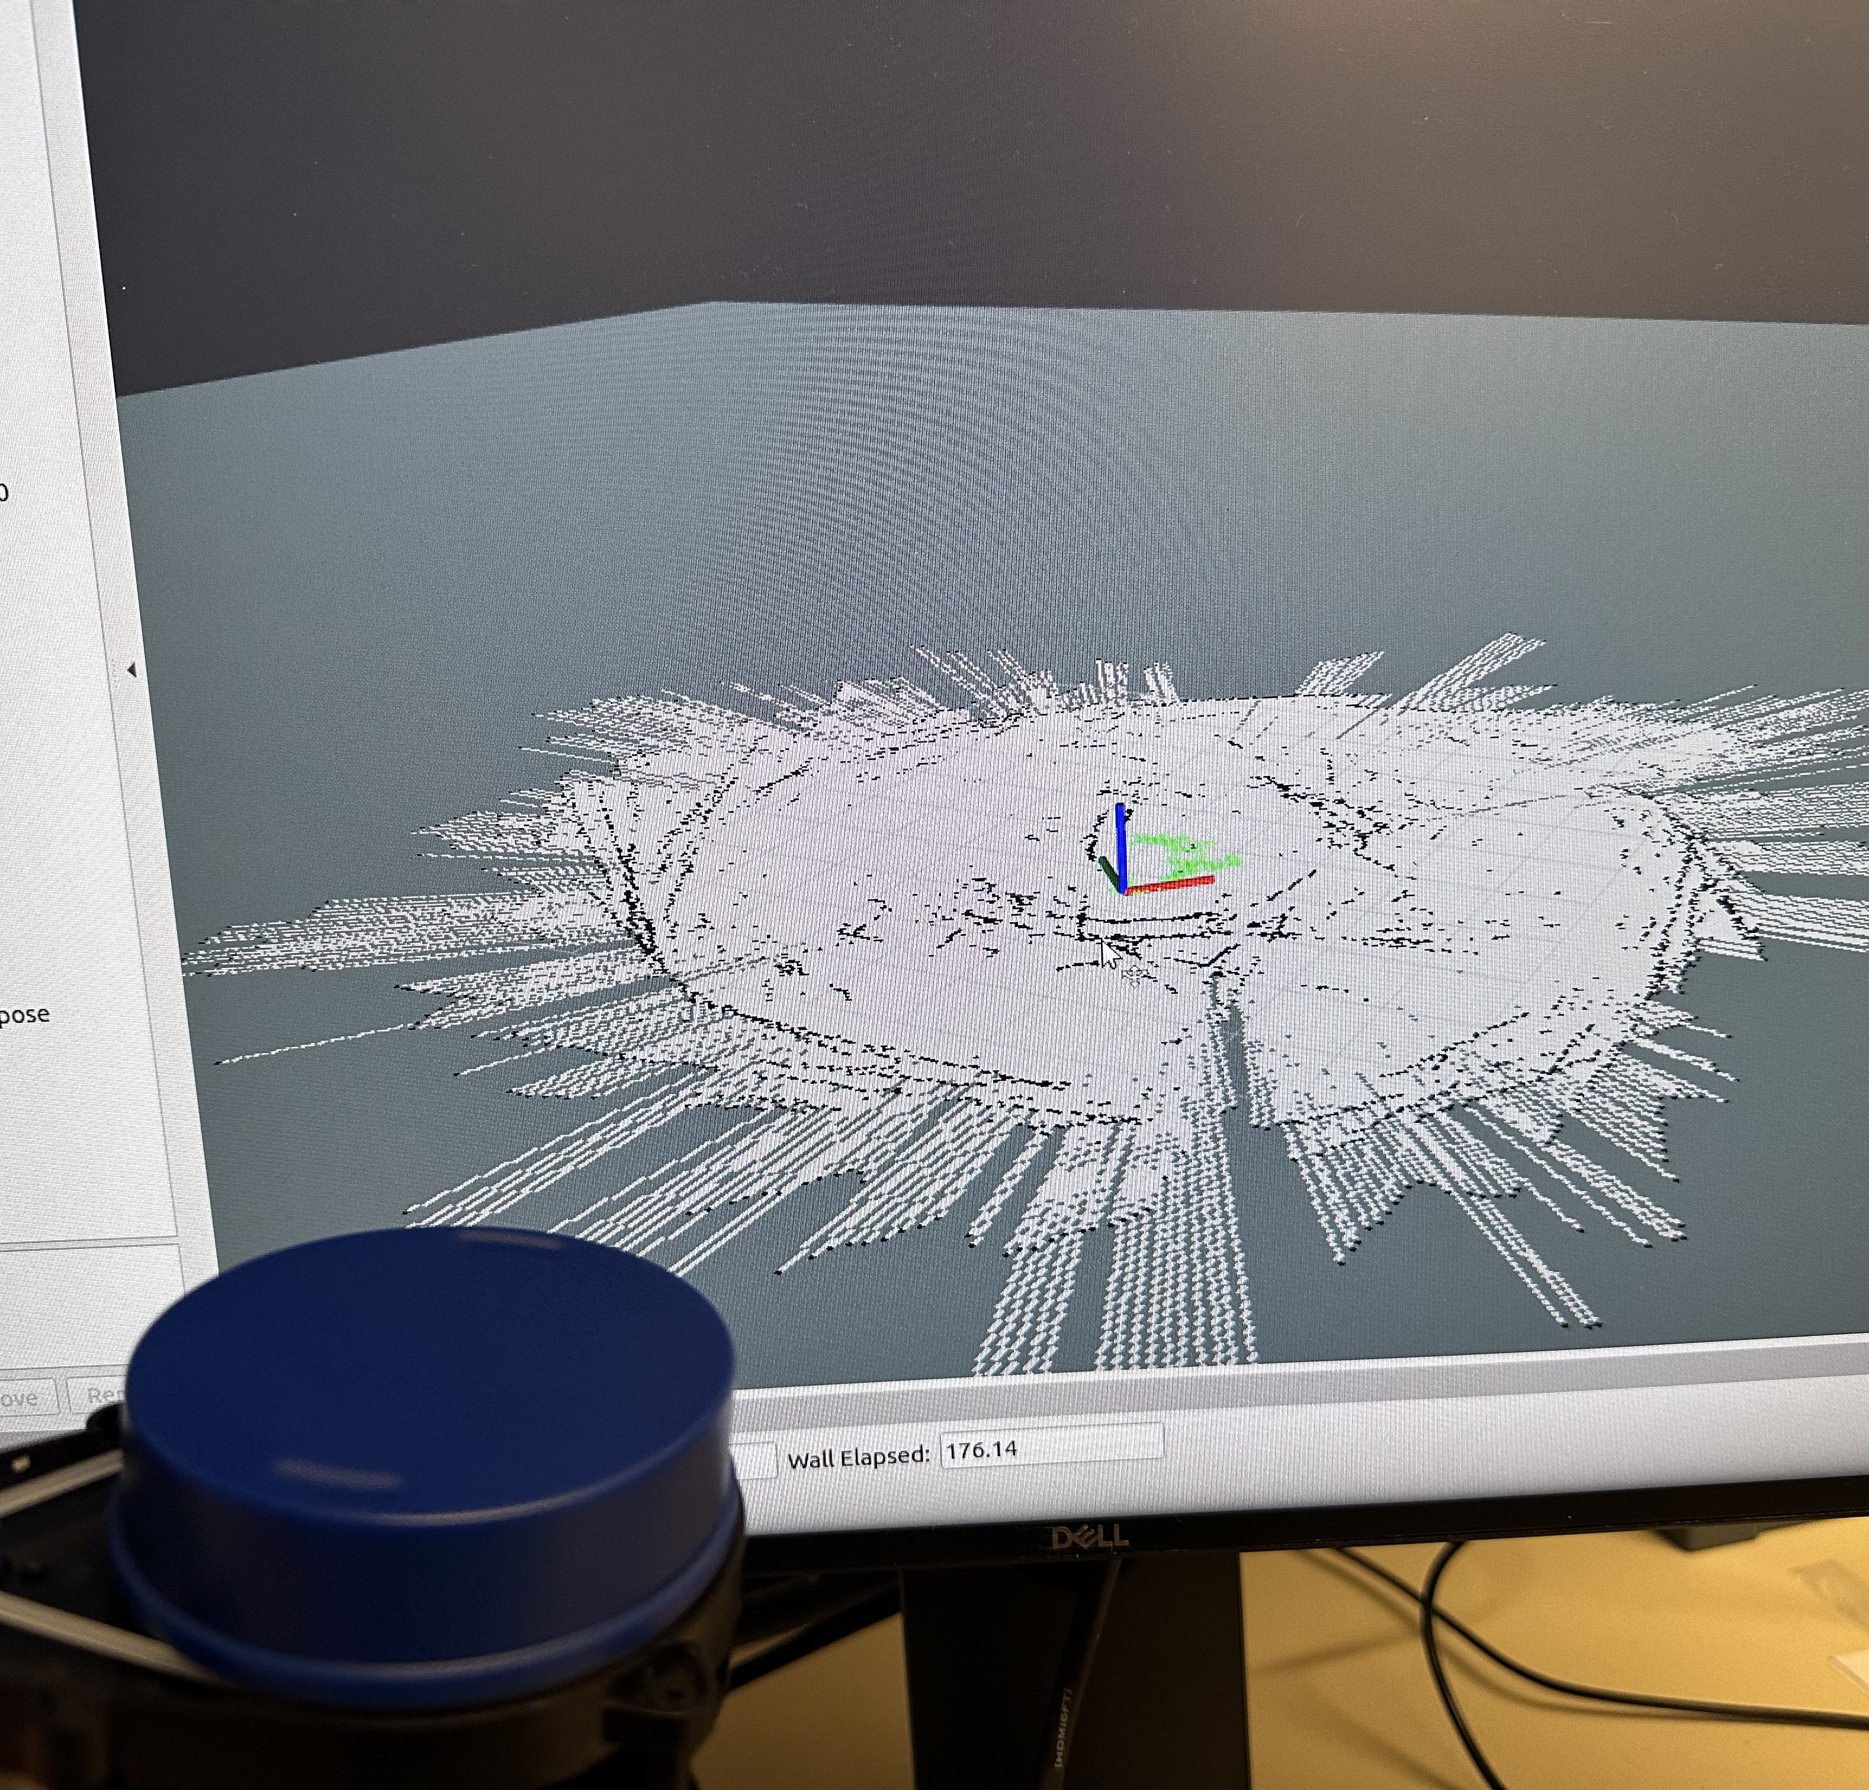

Slide 10
Questions:
How to manage ROS package dependencies?
Need to figure out which packages depend on which Python versions
Way to isolate ROS python to specific bin
How to proceed with SLAM?
Hector SLAM vs. GMapping?
Need for odometry? Encoder vs. optical tachometer?
How to store ideal map (w/ size known)?
How to locate ball position? What if ball is not in camera view?
Necessary?
Field location

Slide 11
Team Roles
Project Manager - Jarod
Point of Contact - Arjun
Budget Manager - Casey
ROS/Hardware (Layout, PCB, CAD, LiDAR):
Cooper, Casey, Jarod, Arjun
Unity Team:
Mason
CV/Image Recognition Team:
K, Julie

Slide 12
ROS (Casey, Cooper)
Previous Work:​
Cont. ROS melodic setup
Setup GNOME VNC server
Created navigation package
(navigation topic + sub/pub)
Started integrating NVIDIA racecar package with ROS
Created package installation instructions doc (OS Flash, VNC, ROS, LiDAR)
Future Work:​
Configure package dependencies
Car tele-op control
Navigation stack (odometry?)

Slide 13
LiDAR (Arjun, Jarod)
Previous Work:
Setup hector SLAM (installed packages, troubleshooted)
Tested SLAM mapping capabilities
Tested for LiDAR crosstalk (no visible issues)
Future Work:
Look into odometry (could provide more accurate results with gmapping)
Mount LiDAR on cars, test mapping in real-world
Use SLAM maps to inform navigation

Slide 14
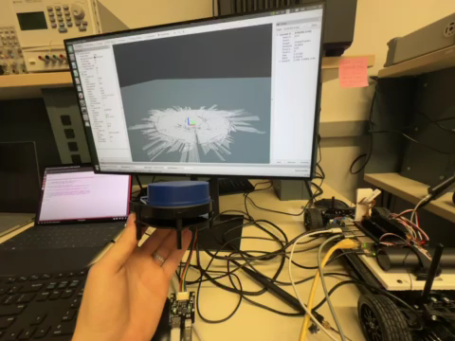
LiDAR (Arjun, Jarod)

Slide 15
Object Recognition (K, Julie)
Previous work:
Object detection (YOLOv7) runs on car 4
Started looking into object following
Future work:
Get object detection working on all cars
May need to update image dataset depending on if field boundaries/cars look the same as previous years
Implement object following onto cars

Slide 16
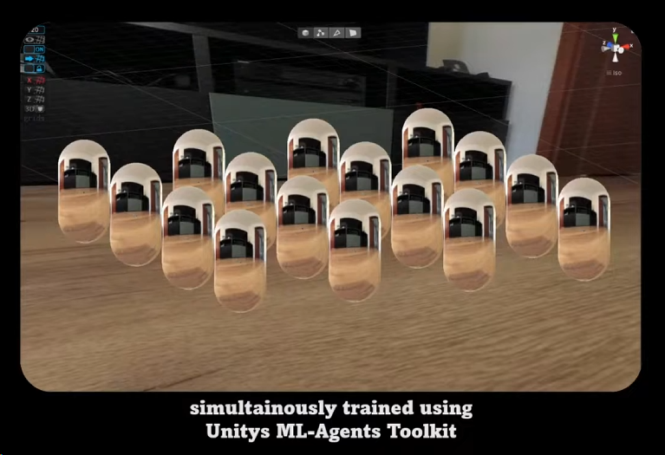
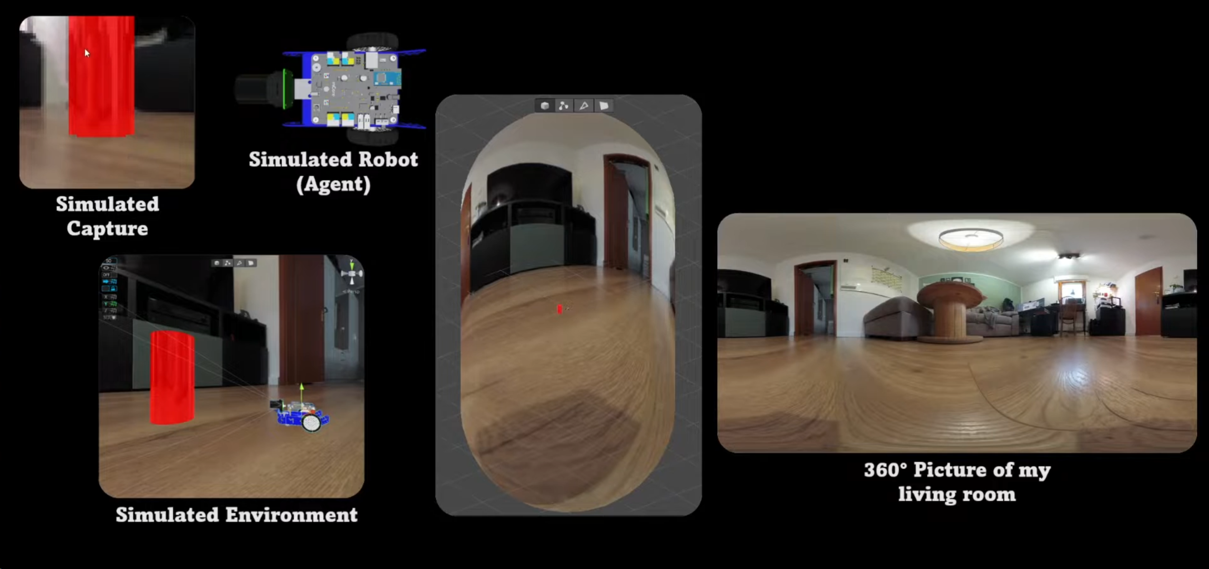
Unity (Mason)
Progress: Optimized the simulation further, looking to re-train some 1v1 fields as the industry mentors suggested.
For integration of Unity Simulation and JetRacer cars IRL:
Just a premature idea to utilize image recognition to identify objects, might require another onboard computer to process this, and a 360 camera could be a good idea.
Plan is to identify the cars and ball, and then execute certain commands in order to complete a 2v2 soccer game. The difficulty here is to stream the camera footage back to the Unity and translate the action values back to the cars.

Slide 17
Previous Year's Work
Built and gained full range of motion of 4 JetRacers using software
Set up a simulation environment to virtually train the agents
Structured a reward system for the reinforcement learning model
Implemented object detection model that identifies a soccer ball, opponent, and goal
Implemented software to follow and strike a ball
Developed logic process for striking a ball into a goal
Simulation results with reward structure demonstrate that agents can be trained to efficiently compete in a 2v2 soccer match
Created a GitHub page documenting the hardware and software instructions to setup JetRacers, a summary of the work completed, and plans for future work

Slide 18
Our Final Deliverables
Demonstrate basic motion of JetRacer: 01/2024
Demonstrate JetRacer Image Recognition for soccer play: 01/2024
Trade study of possible sensor additions: 02/2024
Preliminary Design Review: 02/2024
Showcase vehicle scoring soccer ball in the goal in real-world: 03/2024
Add additional agents in the real world: 04/2024
Final Data Review: 05/2024

